Slide 1

A Reinforcement Learning Project
GROUP 19

Slide 2
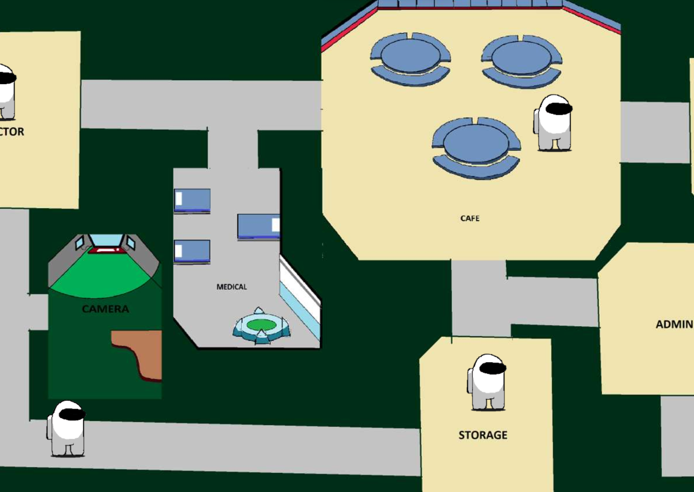
CONTRIBUTORS:
PALKESH JAIN 12141210
AKSHAT ARORA 12140170
DHRUV SAINI 12140590
SHOBHIT JAIN 12141540

Slide 3
Overview
Introduction
Libraries Used
GUI Development
Reinforcement Learning Algorithm
Performance Metrics

Slide 4
Introduction
Objective:
Develop a simple prototype of the popular game "Among Us," incorporating artificial intelligence algorithms for both playing characters.
Characters:
1. Player:
Task: Locate and press the red button.
Objective: Successfully complete the task before falling victim to the imposter.
2. Imposter:
Task: Eliminate the player by any means necessary.
Objective: Prevent the player from completing the task (pressing the red button).

Slide 5
GUI DEVELOPMENT
Game Environment:
Game Environment is a room of 1200 * 800 size(window size).
Player and Imposter Characters:
Created graphical representations of the player and imposter characters. These could be sprites or images that move within the game environment.
Red Button:
There is a circular red button of radius 25px located in room.

Slide 6
Libraries Used
Pygame : Pygame is a cross-platform set of Python modules designed for writing video games. It includes computer graphics and sound libraries. Pygame makes it easier to create simple games and multimedia applications in Python.
Random : The random module in Python provides functions for generating pseudo-random numbers. It's commonly used when you need to introduce randomness into your programs, such as when shuffling elements in a list or generating random integers.
Sys : The sys module provides access to some variables used or maintained by the Python interpreter and functions that interact with the interpreter. It's often used for system-specific parameters and functions like exiting the program (sys.exit()).

Slide 7
Time : The time module provides various time-related functions. It's commonly used for introducing delays in a program using time.sleep() and for measuring time intervals.
Numpy : NumPy is a library for the Python programming language that provides support for large, multi-dimensional arrays and matrices, along with mathematical functions to operate on these elements. It's widely used in scientific and numerical computing.

Slide 8

Reinforcement Learning Algorithm
Q-learning is a model-free reinforcement learning algorithm used to find the optimal action-selection policy for a given finite Markov decision process (MDP). The core idea is to learn a Q-value for each state-action pair, where the Q-value represents the expected cumulative reward for taking a particular action in a particular state.
Q-Learning:
Q-learning is a model-free RL algorithm suitable for MDPs.
It learns a policy for making decisions without explicit knowledge of the environment's dynamics.
Q-Value:
Q-values represent the expected cumulative reward for taking a specific action in a particular state.
Q-values are updated iteratively using the Q-learning update rule.
Q(s,a) is the Q-value for state ss and action aa.
r is the immediate reward received after taking action aa in state ss.
s′ is the next state.
Α is the learning rate, controlling how much the Q-values are updated.
γ is the discount factor, which determines the importance of future rewards.
Exploration and Exploitation:
Exploration involves trying new actions to discover their effects on the environment. Exploration factor is taken 0.1.
Exploitation involves choosing actions with the highest known Q-values to maximize immediate rewards.

Slide 9
Q Learning converges to optimal values Q*
Irrespective of initialization,
Irrespective of action choice policy
Irrespective of learning rate
2. as long as
states/actions finite, all rewards bounded
No (s,a) is starved: infinite visits over infinite samples
Properties of Q-learning

Slide 10
Learning Process:​
The agent explores the environment, updating Q-values based on the observed rewards and learned policies.​
Over time, the agent refines its policy, favoring actions that lead to higher cumulative rewards.​
Application in Game Development:​
Q-learning can be applied to game environments, where states represent different game situations, and actions are the possible moves.​
Advantages:​
Q-learning is model-free, making it suitable for environments with unknown dynamics.​
It can handle large state and action spaces.​
Challenges:​
Q-learning might face challenges in environments with continuous state spaces or complex dynamics.

Slide 11
Components of the Code:
Initialization:
The code initializes the Pygame library and sets up various constants, such as the dimensions of the game window, player and imposter speeds, and Q-learning parameters.
Q-Tables:
Two Q-tables (Q_table and Q_table_imp) are created to store Q-values for each state-action pair for the player and imposter, respectively.
Player and Imposter Classes:
The Player class is defined to represent both the player and imposter.
The choose_action method is used to select an action either randomly (exploration) or based on the highest Q-value (exploitation).
The update_q_table method is responsible for updating the Q-values based on the Q-learning update rule.

Slide 12
Game Loop:​
The main game loop runs for a specified number of episodes.​
For each episode, a new instance of the Player and Imposter classes is created.​
Within the loop, both the player and imposter choose actions based on their Q-values, update their positions, and receive rewards based on their movements.​
Q-tables are updated using the Q-learning update rule.​
Visualization:​
Pygame is used for visualization. The game window displays the player, imposter, and a reward circle.​
The game terminates when either the player or imposter reaches the reward circle, and the Q-tables are updated accordingly.​
Training Statistics:​
The code tracks various statistics during training, such as player and imposter win rates, time taken for each episode, and episode rewards.​
Plotting:​
Matplotlib is used to create plots of win rates, time taken, and rewards over episodes.​

Slide 13
Efficiency of Algorithm
Evaluating the efficiency of an algorithm can be done through various aspects such as convergence speed, resource utilization, and the effectiveness of learning. Let's analyze the efficiency of the Q-learning algorithm in the provided code:
Convergence Speed:
The convergence speed refers to how quickly the algorithm learns an optimal policy.
In the code, the number of episodes (episodes) is set to 102102, which might not be sufficient for complex environments.
Increasing the number of episodes could potentially improve convergence.
Resource Utilization:
The code uses a Q-table to store Q-values for each state-action pair, which might become impractical for large state spaces.
For more complex environments, alternative methods like deep reinforcement learning with neural networks may be more efficient.

Slide 14
Exploration-Exploitation Balance:
The epsilon parameter controls the balance between exploration and exploitation.
A higher value of epsilon promotes more exploration, while a lower value favors exploitation.
Fine-tuning this parameter could impact the algorithm's efficiency.
Game Environment Complexity:
The efficiency of Q-learning depends on the complexity of the game environment.
The code seems to model a relatively simple environment with limited state and action spaces.
Learning Parameters:
The learning rate (learning_rate) and discount factor (discount_factor) are crucial parameters in Q-learning.
Adjusting these parameters might influence the algorithm's efficiency.
Visualization Overhead:
The Pygame library is used for visualization, which introduces overhead in rendering the game.
The rendering time might affect the overall training efficiency.
Win Rates and Rewards:
Monitoring win rates and rewards over episodes provides insights into the learning progress.
If the win rate converges to an acceptable level and rewards stabilize, it indicates the algorithm is learning efficiently.

Slide 15
Game Statistics discount factor = 0.95
α = 0.9
€= 0.1

Slide 16
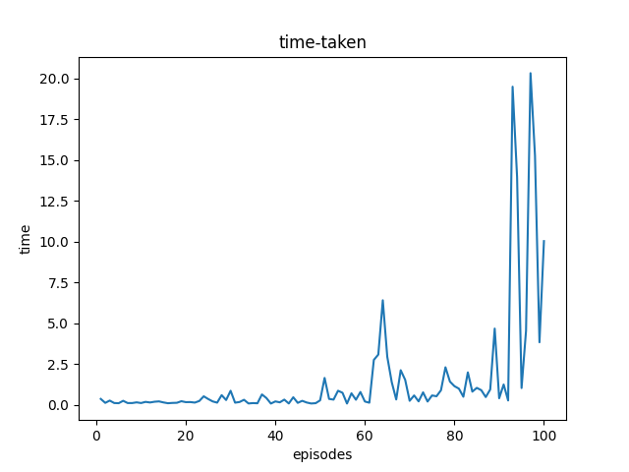
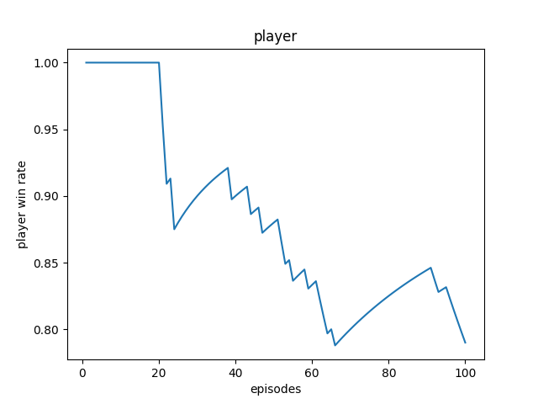
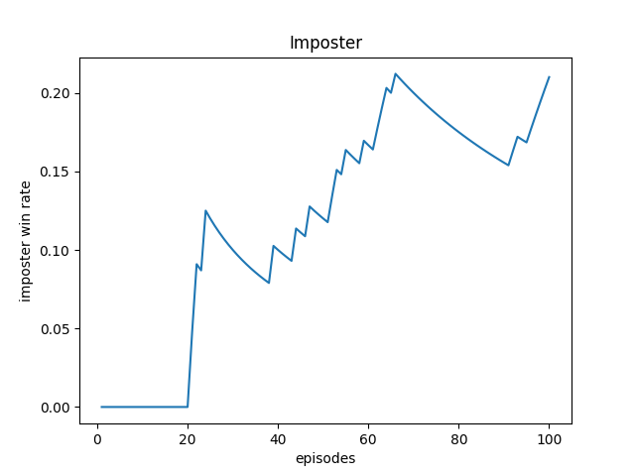
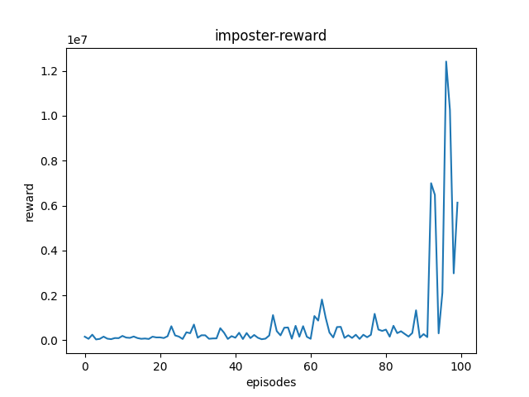
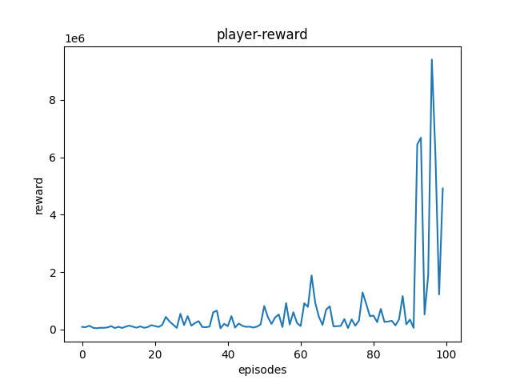
Reward = 10, Penalty = 20, discount factor=0.95
Episodes = 100

Slide 17
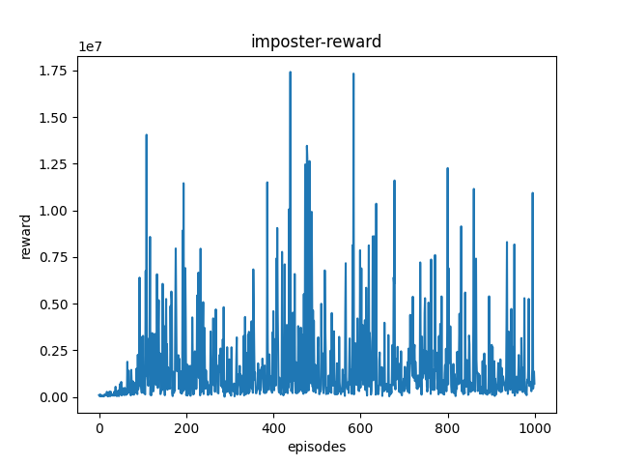
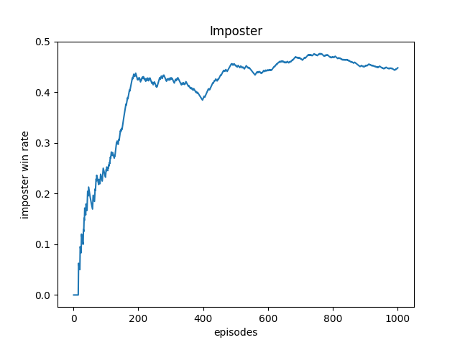
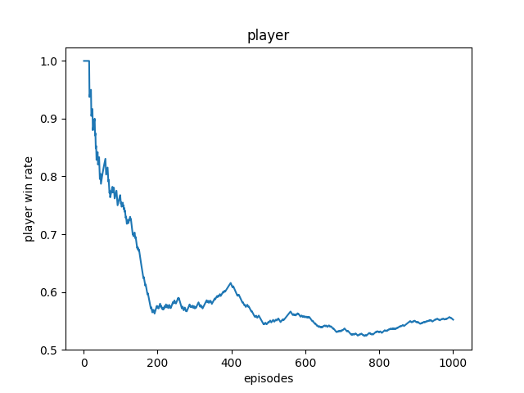
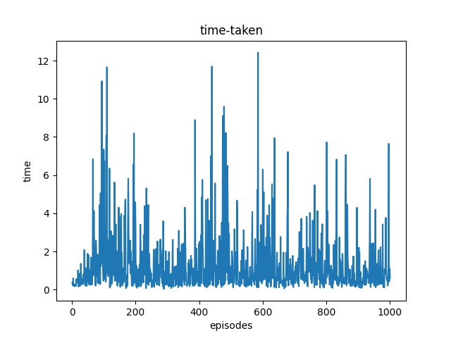
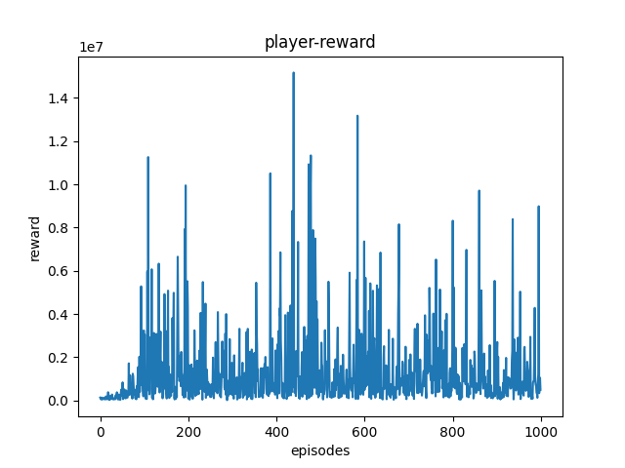
Reward = 10, Penalty = 20
Episodes = 1,000

Slide 18
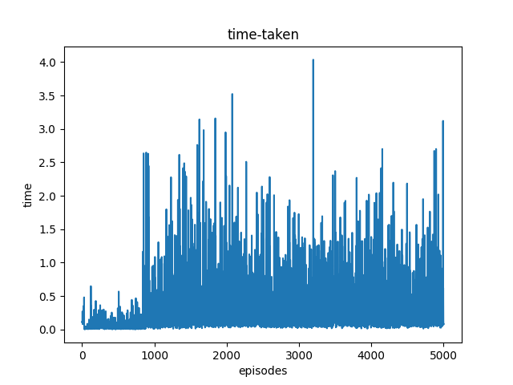
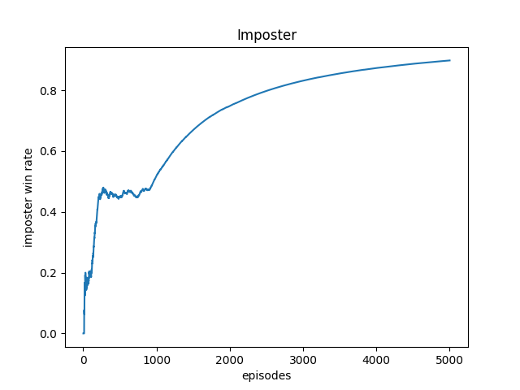
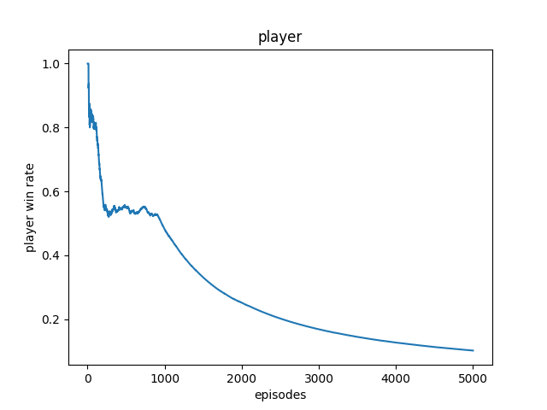
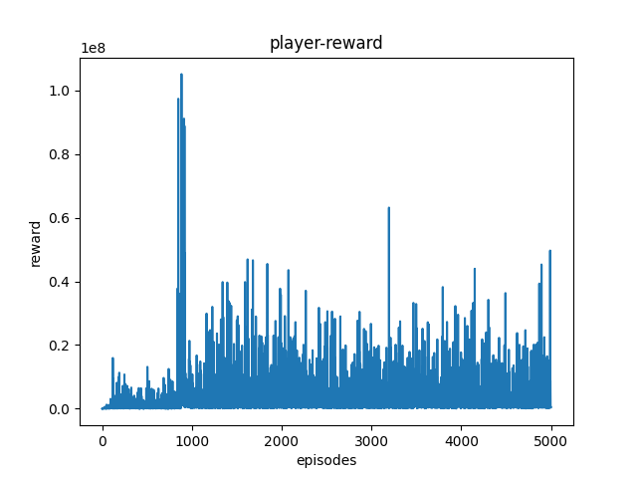
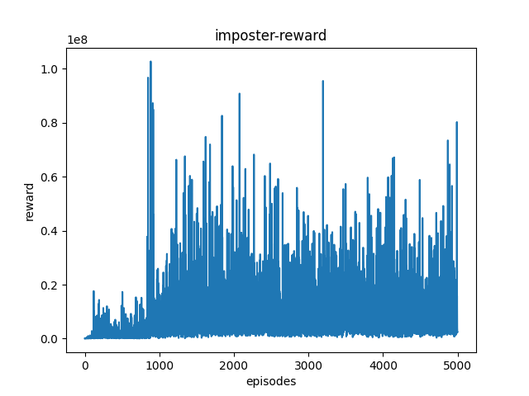
Reward = 10 , penalty = 20
Episodes = 5,000

Slide 19
Game Statistics for Diff. Reward Set

Slide 20
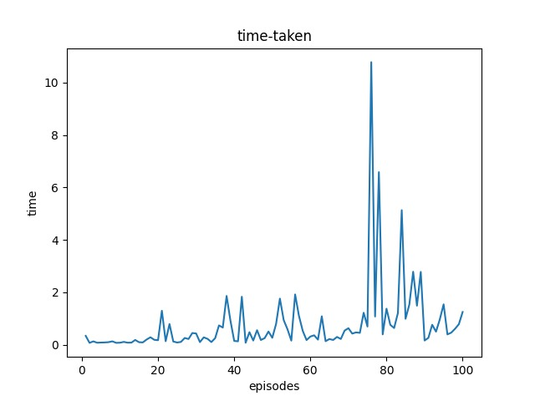
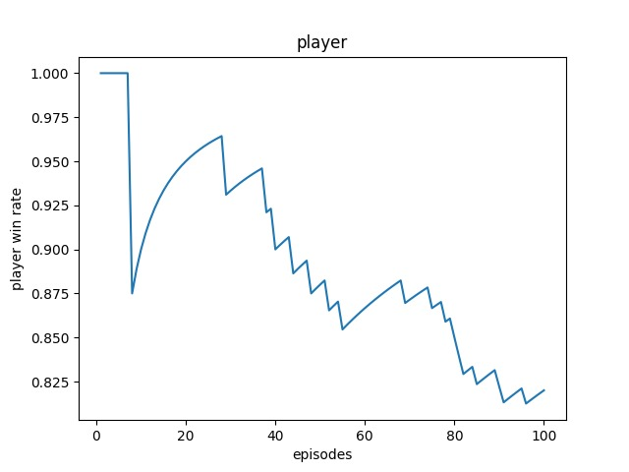
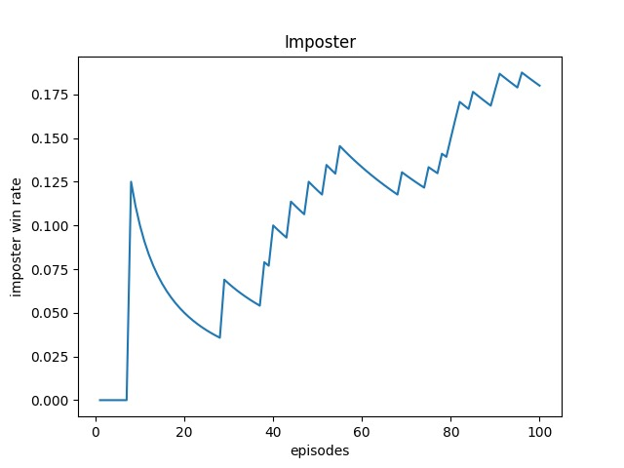
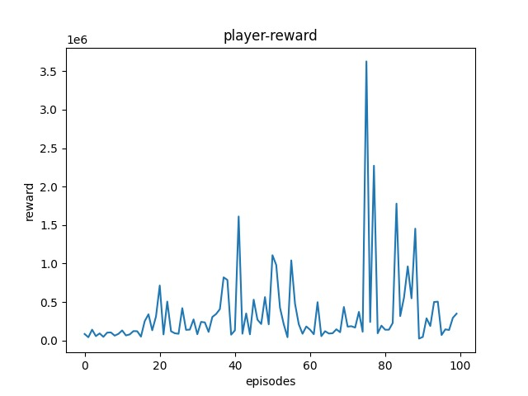
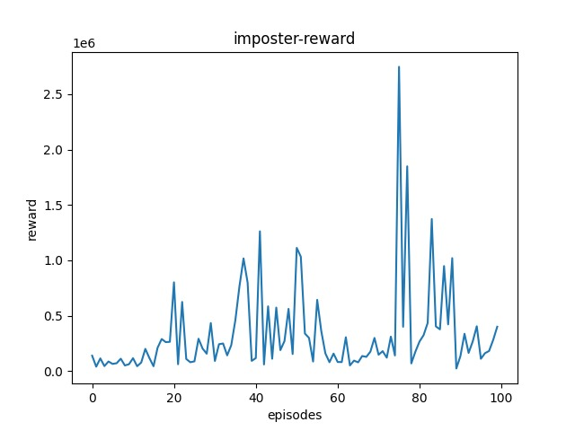
Reward = 10 , penalty = 10, discount factor = 0.95
Episodes = 100

Slide 21
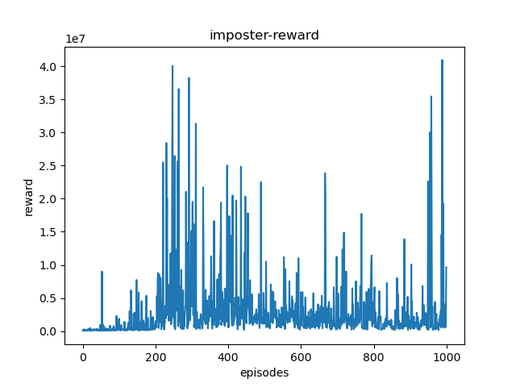
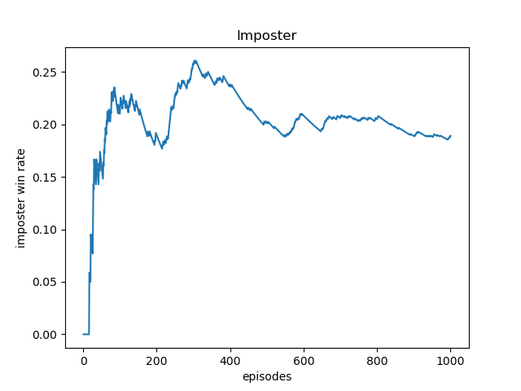
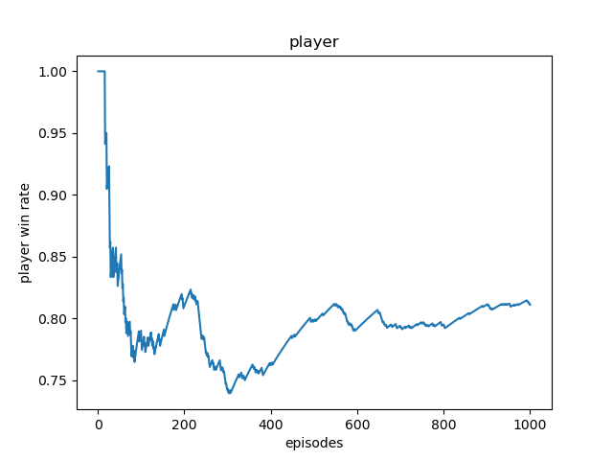
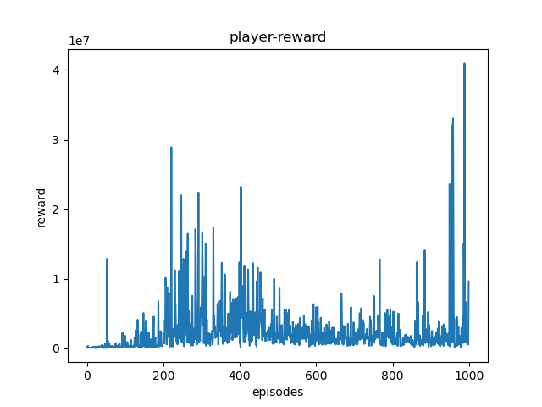
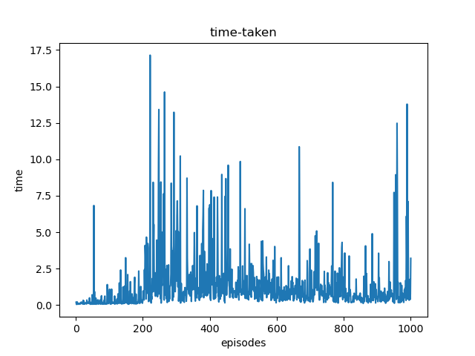
Reward = 10, Penalty = 20, discount factor =0.35
Episodes = 1,000

Slide 22
Thank You

